Slide 1


Diabetes Self-Management and Complications
Dr. Haleama Al Sabbah
College of Health Sciences
Abu Dhabi University
Abu Dhabi, UAE
Sunday, 18th August, 2024

Slide 2
Content
Introduction
Study 1
Study 2
Study 3
Q & A

Slide 3

Introduction

Slide 4
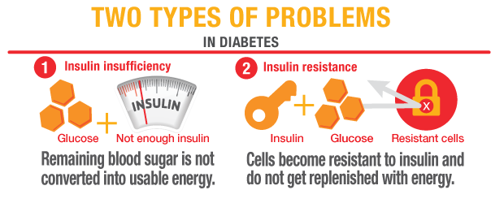
What is Diabetes?
Body does not make or properly use insulin:
  no insulin production
  insufficient insulin production
  resistance to insulin’s effects
No insulin to move glucose from blood into cells:
  high blood glucose means:
    cells starve
    short and long-term complications
    (American Diabetes Association)
Notes:
Diabetes is a chronic disease in which the body does not make or properly
use insulin, a hormone that is needed to convert sugar, starches, and other
food into energy by moving glucose from blood into the cells.
People with diabetes have increased blood glucose (sugar) levels for one or
more of the following three reasons: Either
No insulin is being produced,
Insulin production is insufficient, and/or
The body is resistant to the effects of insulin.
As a result, high levels of glucose build up in the blood, and spill into the
urine and out of the body. The body loses its main source of fuel and cells
are deprived of glucose, a needed source of energy. High blood glucose
levels may result in short and long term complications over time.

Slide 5
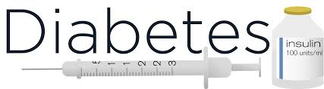
Diabetes mellitus (DM) is a metabolic disorder of multiple etiology characterized by chronic hyperglycemia with disturbances of carbohydrate, fat and protein metabolism resulting from defects in insulin secretion, insulin action, or both (Craig, et al., 2014; Hamdan, 2007; WHO, 1999).
Symptoms: thirst, polyuria, blurring of vision, and weight loss.

Slide 6
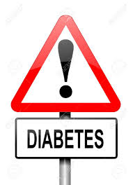
Type 2 diabetes
Results from a combination of resistance to insulin action and an inadequate compensatory insulin secretory response from the cells
(WHO, 2016; Craig, et al., 2014)

Slide 7
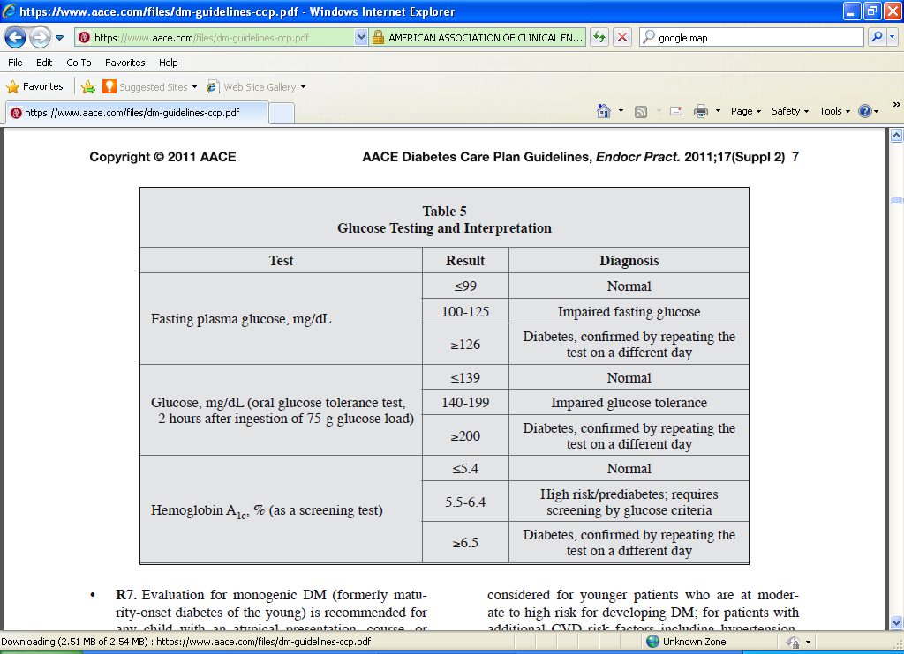

Slide 8
Complications
Risk factors of macro-vascular complications:
Elderly
Being male
Lower level of physical activity
History of smoking
Diagnosis of high cholesterol
Risk factors of micro-vascular complications:
Diabetes diagnosis of 10 or more years
History of smoking
Diagnosis of hypertension
(Tracey, M., et al., 2016)

Slide 9
Complications
The glycemic control (HbA₁c) should always be in an acceptable level to delay the onset of any further complication of the disease.
The key causes of morbidity and mortality among type 2 diabetes mellitus patients are microvascular, macrovascular and neurological complications.
An association has been found between the heart rate variability and T2DM among diabetic population in the UAE.
(Ab Hamid, M., et al., 2016)
(Khandoker, A., et al., 2017)

Slide 10
Poorly controlled diabetes is associated with long term damage and failure of various organs:
Retinopathy which is the leading cause of blindness especially in adult people suffering from diabetes (Hamdan, 2007)
Nephropathy as 10–20% of patients with diabetes die from renal diseases (WHO Media Centre, 2012)
Neuropathy which affect up to 50% of patients with diabetes (Alkaissi, 2013)
Cardiovascular and cerebrovascular diseases whereas the rate of heart diseases and stroke in adults with diabetes is 2–4 times higher than those without diabetes (El-Barbari, 2003).

Slide 11

The importance of doing research?

Slide 12
Diabetes is Managed, But it Does Not Go Away.
The importance of diabetes educational intervention in improving self-management of patients suffering from diabetes is essential in preventing these complications.
GOAL:
To maintain target blood glucose
Notes:
Whether we consider type 1 or type 2 diabetes, the goal of effective diabetes management is to control blood glucose levels by keeping them within a target range that is individually determined for each child. Optimal blood glucose control helps to promote normal growth and development and allows for optimal learning. It is also needed to prevent the immediate dangers of blood glucose levels that are either too high or too low. Research has shown that maintaining blood glucose levels within the target range can prevent or delay the long-term complications of diabetes such as heart attack, stroke, blindness, kidney failure, nerve disease, and amputations of the foot or leg.
When insulin is no longer made, it must be obtained from another source--insulin shots or an insulin pump. All people with type 1 diabetes must take insulin. People with type 2 diabetes use diet and exercise, and oral medications, and/or insulin to manage their disease. Neither insulin nor other medications, however, are cures for diabetes: they only help control the disease.

Slide 13
Significance of the Studies:
Lifestyle changes, rapid urbanization and socioeconomic development, stress, smoking, and changes in food habits has increased the risk of non-communicable diseases especially diabetes mellitus.
Diabetes complications can be prevented if the glycemic status of patients with diabetes is maintained within a nearly normal range.
Therefore, patient education is critical in controlling blood glucose levels within the normal range.
Literature review indicated that anthropometric measurements , glycemic control and patient’s knowledge of diabetes self- management are all improved by diabetes education

Slide 14
Diabetes studies
Study 1: Diabetes Self-Management
Study 2: Diabtes Education Program
Study 3: Diabtes Complications

Slide 15
Study 1

Slide 19
Study 2

Slide 20
Diabetes Education Program on Type 2 Diabetic Patients

Slide 22


objectives

Slide 23
Main Objective
Measuring the effect of diabetes educational intervention program for patients suffering from type 2 diabetes.
In this study, we have evaluated the effectiveness of diabetes educational intervention program on patients with type 2 diabetes

Slide 24
Methods:
Study Design
Before and After (Pre-test and Post-test) study was carried based on educational intervention program.

Slide 25
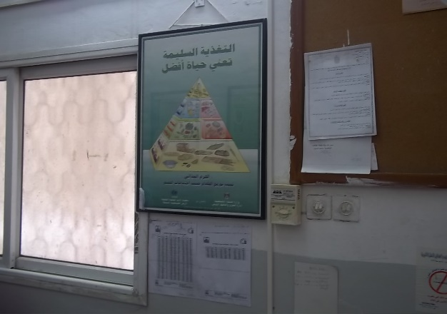
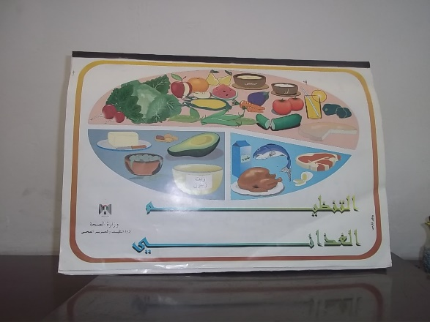

Slide 26
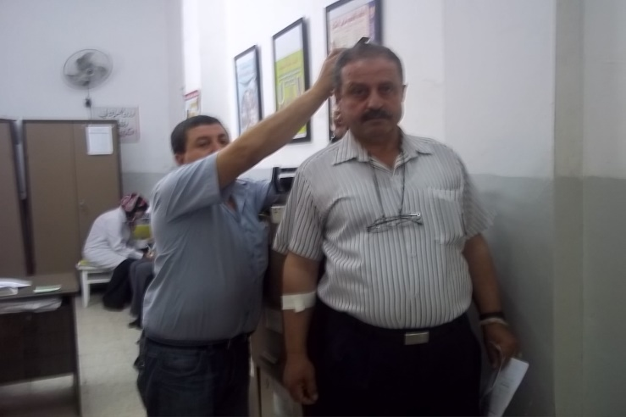
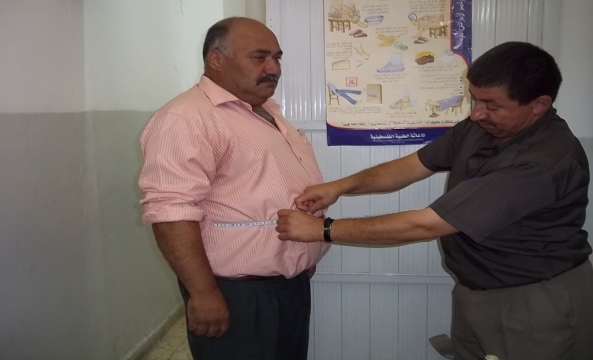

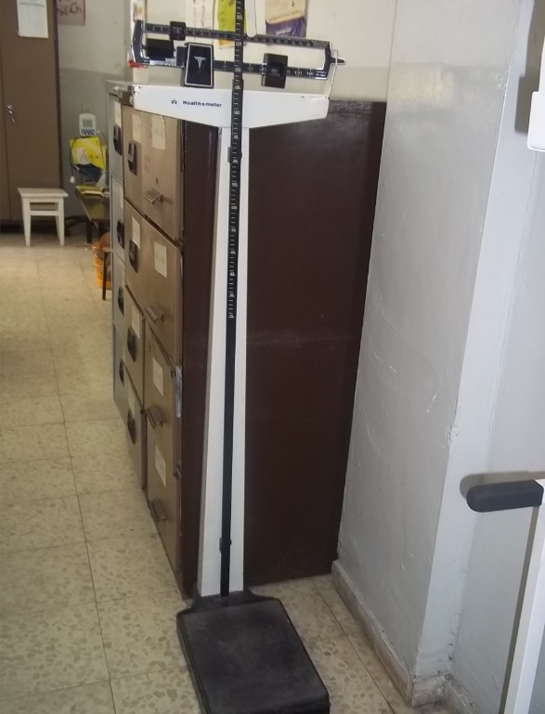
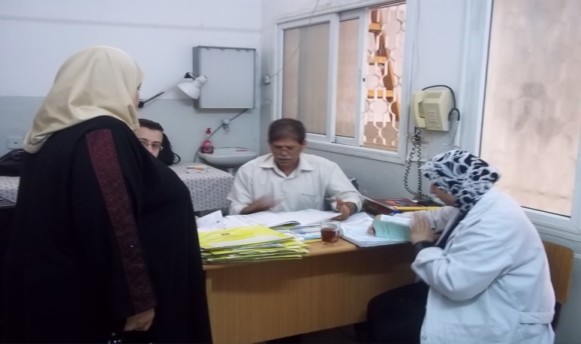

Slide 27
Results

Slide 28
Anthropometric Measurements at pre and post educational intervention program
BMI (Mean± SD) was decreased significantly after conducting the educational intervention program (32.1±5.76 to 31.23±5.8) (p <0.001).

Slide 29
Lab tests at pre and post educational intervention program
A significant decrease was reported in glycosylated hemoglobin (Mean± SD) after the intervention program (8.57± 1.21 to 7.95±1.42) (p<0.001).

Slide 30
Knowledge Scores before and after Educational intervention
A significant increase in knowledge evaluation test scores (Mean± SD) were shown after the educational intervention program (60.6±20.7 to 78.1±13.4) (p <0.001).
Sum of knowledge questionnaire score (100) | *M score ± #SD | t-value | P - value
Before Intervention | 60.60 ± 20.65 | - 15.654 | 0.000
After Intervention | 78.1 ± 13.40
* Mean
# Standard Deviation

Slide 31
Study 3

Slide 32
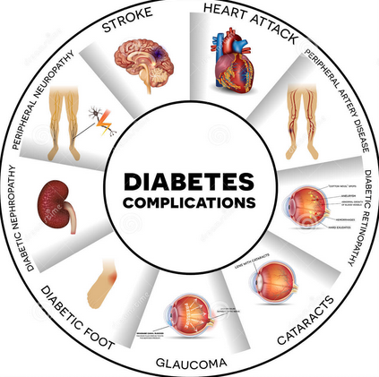
The Prevalence of Complications in Type 2 Diabetics in Diabetes Centers in Dubai

Slide 34
Poor management
Complications
Loss of concentration
Short-term impairments
Long-term impairment
Heart Palpitations
Micro-vascular
Macro-vascular
Anxiety
Neuropathy
Stroke
Dizziness
Nephropathy
Heart attacks
Retinopathy
Peripheral Vascular Disease
(Leontis & Hess-Fischl, 2016; McCulloch, 2016)

Slide 35
Main Objective
To identify the prevalence of complications in Type 2 diabetics in The Diabetes & Endocrine Center, and RAK Diabetes Center in Dubai.

Slide 36
Methodology
Study Design
Descriptive Analytical Study
Study Settings
The Diabetes & Endocrine Center
RAK diabetes Center
Sampling methodology: Random Sampling
Population: Diabetics Type 2 adults in two diabetes centers in Dubai

Slide 37
Results

Slide 38

Results: Prevalence of types of Complications
Hyperlipidemia (84%)
Neuropathy (34%)
Dyslipidemia (32%)
Retinopathy (28%)
Lethargy (21.3%)
Nephropathy (16.7%)
Joint & Bone pain (16%)
Numbness of feet and hands (12.7%)
n = 150

Slide 39
Association between HbA₁c and type of complications
HbA₁c:
    Normal Values count: 53 (35.5%)
    Abnormal Values count 97 (64.7%)

Slide 40
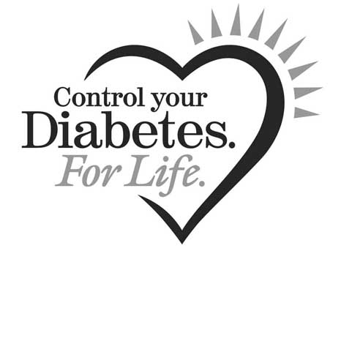
Thank you
Q & A
haleemah.alsabah@adu.ac.ae
haleama@hotmail.com

